Slide 1
Proiect Microcontrollere Si Microprocesoare
Robot care evita obstacolele
Realizat de :
-Stoica Alexandru Mihail

Slide 2
Componente
Șasiu - 2 placi de plexiglas
2 role
O placuta Arduino Uno
Senzor Ultrasonic HC SR-04
2 motoare DC
O baterie 9V
Driver Motoare L298
Buton Pornit/Oprit
Cabluri

Slide 3
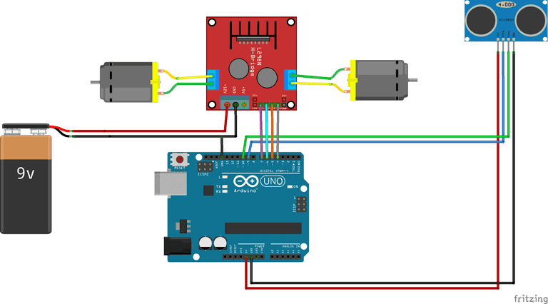
Schema Digitala

Slide 4
Argumente
Deoarece a reprezentat o provocare
A parut un proiect interesant
Ne-a inspirat conceptul
Este un proiect potrivit pentru incepatori
Amuzament
Lucrul in echipa

Slide 5
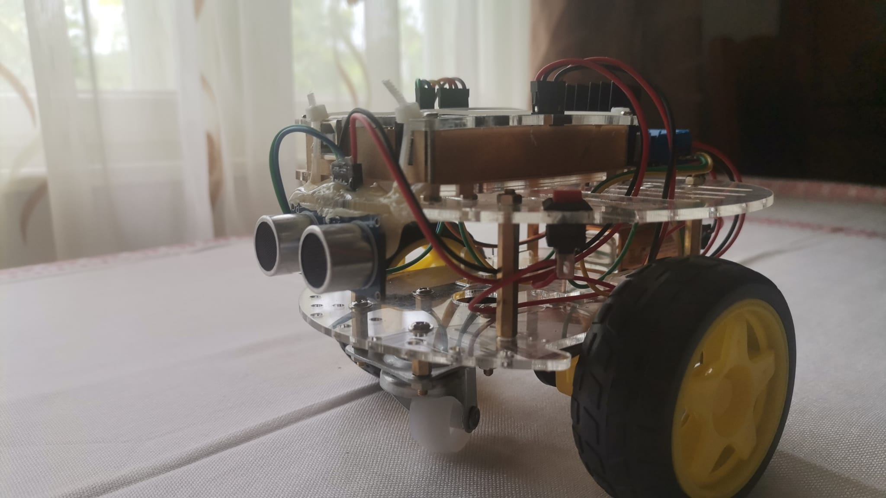
Poza

Slide 6
Cod
int trigPin = 9;
int echoPin = 10;
int revleft4 = 4;
int fwdleft5 = 5;
int revright6 = 6;
int fwdright7 = 7;
long duration, distance;
void setup() {
delay(random(500,2000));
Serial.begin(9600);
pinMode(revleft4, OUTPUT);
pinMode(fwdleft5, OUTPUT);
pinMode(revright6, OUTPUT);
pinMode(fwdright7, OUTPUT);
pinMode(trigPin, OUTPUT);
pinMode(echoPin, INPUT);
}
void loop() {
digitalWrite(trigPin, LOW);
delayMicroseconds(2);
digitalWrite(trigPin, HIGH);
delayMicroseconds(10);
duration = pulseIn(echoPin, HIGH);
distance = duration / 58.2;
delay(10);
if (distance > 19)
{
digitalWrite(fwdright7, HIGH);
digitalWrite(revright6, LOW);
digitalWrite(fwdleft5, HIGH);
digitalWrite(revleft4, LOW);
}
if (distance < 18)
{
digitalWrite(fwdright7, LOW);
digitalWrite(revright6, LOW);
digitalWrite(fwdleft5, LOW);
digitalWrite(revleft4, LOW);
delay(500);
digitalWrite(fwdright7, LOW);
digitalWrite(revright6, HIGH);
digitalWrite(fwdleft5, LOW);
digitalWrite(revleft4, HIGH);
delay(500);
digitalWrite(fwdright7, LOW);
digitalWrite(revright6, LOW);
digitalWrite(fwdleft5, LOW);
digitalWrite(revleft4, LOW);
delay(100);
digitalWrite(fwdright7, HIGH);
digitalWrite(revright6, LOW);
digitalWrite(revleft4, LOW);
digitalWrite(fwdleft5, LOW);
delay(500);
}
}

Slide 7
Va multumim pentru atentie !!

Slide 8
BIBLIOGRAFIE
https://www.arduino.cc/en/Guide/ArduinoUno
https://www.popsci.com/diy/article/2013-01/program-arduino-few-simple-steps/

